Slide 1
Exoplanet meeting 05/11/21 – E01

Slide 2
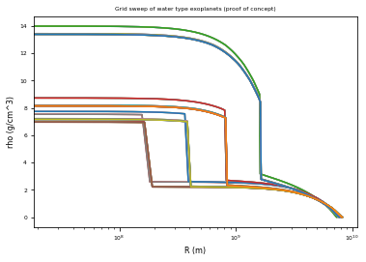
Exoris
Radius Density graph produced using Exoris with S. Mazevet’s help, exploring grid searches using custom external Fortran code

Slide 3
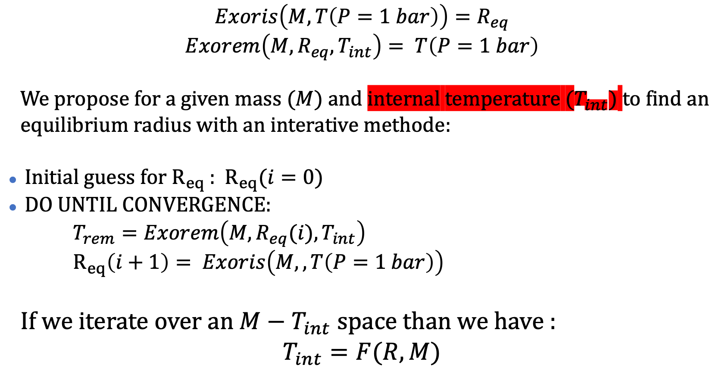
Exoris/Exorem
$$Exoris\left(M, T\left(P=1 bar\right)\right)=R_{eq}$$
$$Exorem\left(M,R_{eq},T_{int}\right)= T\left(P=1 bar\right)$$
We propose for a given mass ($M$) and internal temperature ($T_{int})$ to find an equilibrium radius with an interative methode:
Initial guess for $R_{eq}$ : $R_{eq}(i=0)$
DO UNTIL CONVERGENCE:
$T_{rem}=Exorem\left(M,R_{eq}(i),T_{int}\right)$
$R_{eq}\left(i+1\right)= Exoris\left(M,,T\left(P=1 bar\right)\right)$
If we iterate over an $M−T_{int}$ space than we have :
$$T_{int}=F(R,M)$$

Slide 4
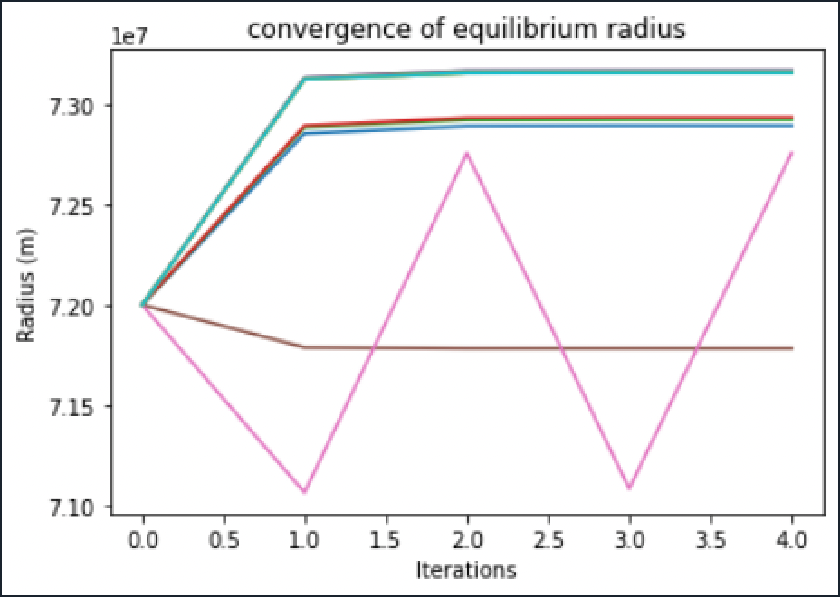
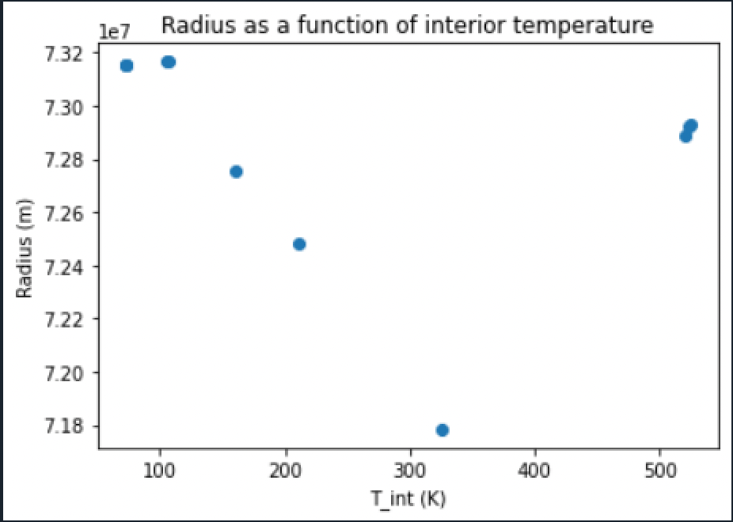
Prelimanary results
Problème de convergence Exorem

Slide 5
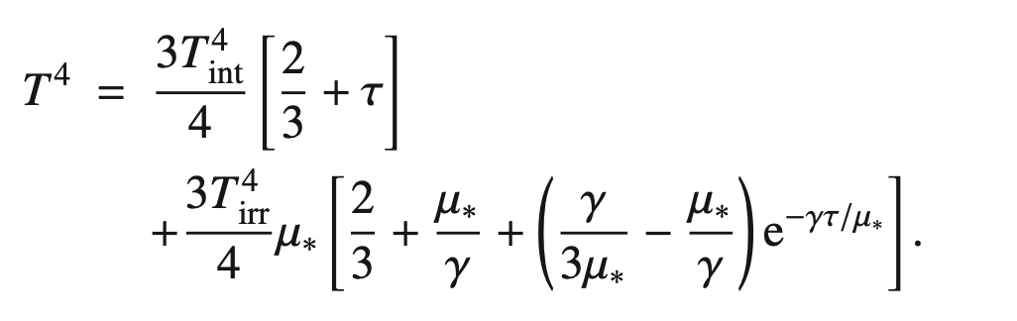
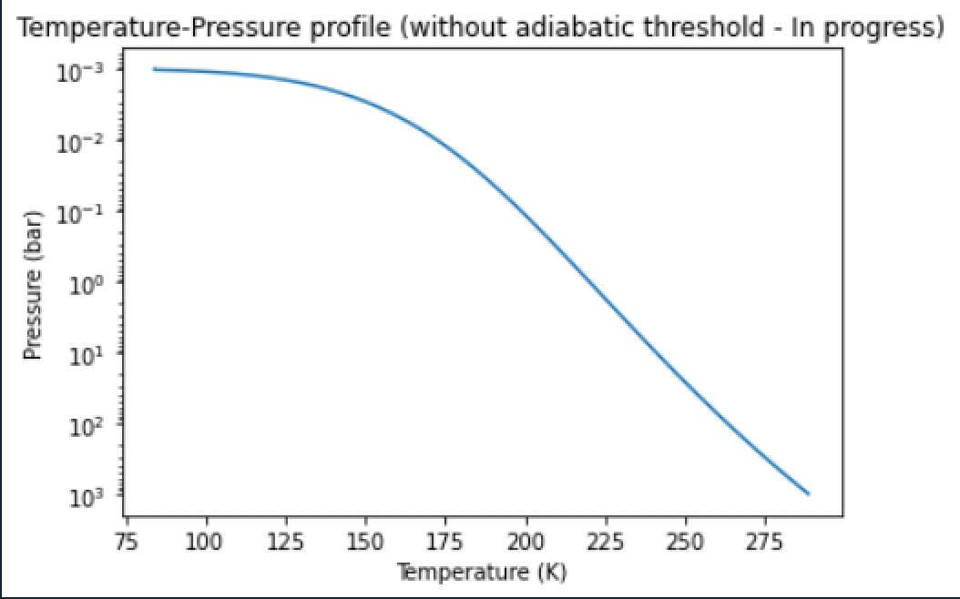
Eddington relation – Theoretical profiles
T. Guillot (2010) – For grey atmospheres (constant absorption at all frequencies)

Slide 6
Flow chart of process
Initialise radius (guess)
Calculate theoretical temperature profile
Use profile to help exorem converge
Loop between exorem and exoris until convergence
Or Create grid of exoris models and align temperature
Theoretical profile can be used directly for exoris

